Slide 1
Introduction to
ArcGIS automation through scripting with Python

Slide 2
Who are you?
UG
Post doc
PhD
Ecologist and part-time physical oceanographer, experienced in most marine habitats, particular expertise with engineering species (corals, sponges, macroalgae).
Multidisciplinary, computationally and technically minded, specializations in spatial analysis, statistics, data visualization and data acquisition.
International research experience, many studies conducted collaboratively with colleagues from around the world.
Dedicated to Open Source, Open Access and Open Data movements.
Faculty
Since August 2018

Slide 3
28
5

Slide 4
Course goals
Expose you to the Python programming language and provide opportunity to practice using basic functionality.
Introduce arcpy and how this can be used to automate and extend geoprocessing tasks.
Provide you with the skills needed to successfully develop Python tools that can be used, not only by yourself, but external users.
Provide practice in the use of Github as supplementary tool for code dissemination and storage.

Slide 5


Slide 6
What is Python and why use it?
Python is an interpreted, object-oriented, high-level programming language with dynamic semantics. Its high-level built in data structures, combined with dynamic typing and dynamic binding, make it very attractive for Rapid Application Development, as well as for use as a scripting or glue language to connect existing components together. Python's simple, easy to learn syntax emphasizes readability and therefore reduces the cost of program maintenance. Python supports modules and packages, which encourages program modularity and code reuse. The Python interpreter and the extensive standard library are available in source or binary form without charge for all major platforms, and can be freely distributed.
Often, programmers fall in love with Python because of the increased productivity it provides. Since there is no compilation step, the edit-test-debug cycle is incredibly fast. Debugging Python programs is easy: a bug or bad input will never cause a segmentation fault. Instead, when the interpreter discovers an error, it raises an exception. When the program doesn't catch the exception, the interpreter prints a stack trace. A source level debugger allows inspection of local and global variables, evaluation of arbitrary expressions, setting breakpoints, stepping through the code a line at a time, and so on. The debugger is written in Python itself, testifying to Python's introspective power. On the other hand, often the quickest way to debug a program is to add a few print statements to the source: the fast edit-test-debug cycle makes this simple approach very effective.
https://www.python.org/doc/essays/blurb/

Slide 7
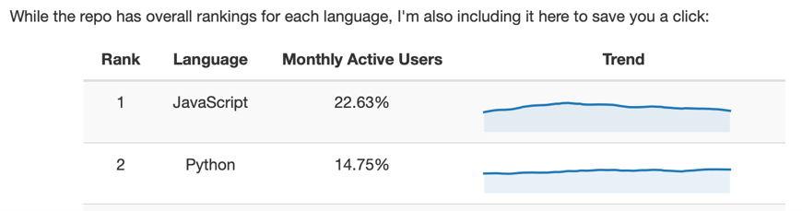
What is Python and why use it?
Just to reiterate:
Easy to read code.
Supports modules and packages (e.g. arcpy).
Free and open source.
Python increases productivity.
Easy edit-test-debug cycle:
Ideal for new programmers and those that are casual code users.
Vastly popular:
#2 On Github for repos.
Lots of code snippets on the internet
https://www.benfrederickson.com/ranking-programming-languages-by-github-users/

Slide 9
What is ArcGIS and why use arcpy?
ArcGIS has been developed over several decades.
Prior to this, we had:
Arc/INFO workstation
ArcView 3.x desktop
Released in 1999, ArcMap 8 was released.
GUI and had some geoprocessing power, but no real environment to work with spatial data in a command line/programming environment.
Strengths are the GUI, Toolboxes, ModelBuilder (introduced in ArcMap 9), standards and extensions (Spatial Analyst, 3D analyst).
Version 10 introduced the arcpy package (can be shown as ArcPy).
Game changer for GIS programmers.
Allows us to interface with other packages.
Rarely need the GUI for any reason but to view/check data.

Slide 10

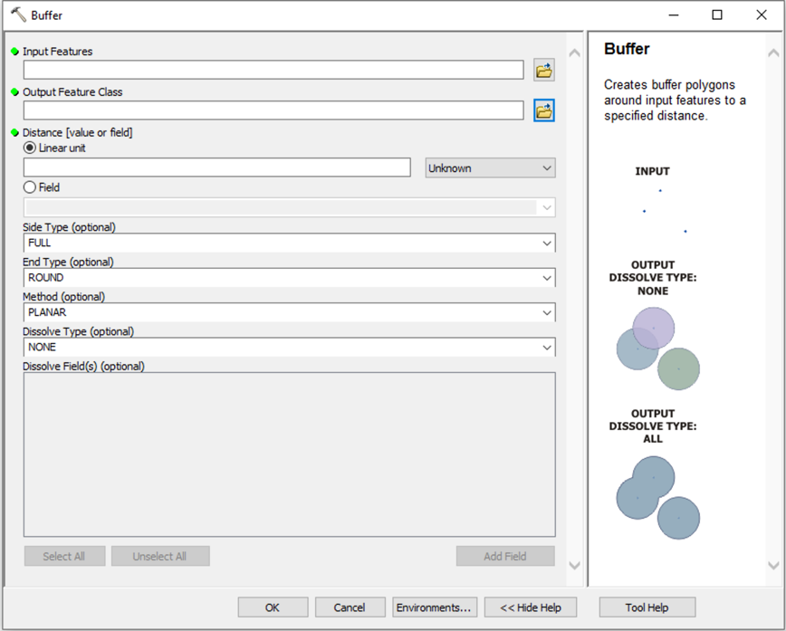
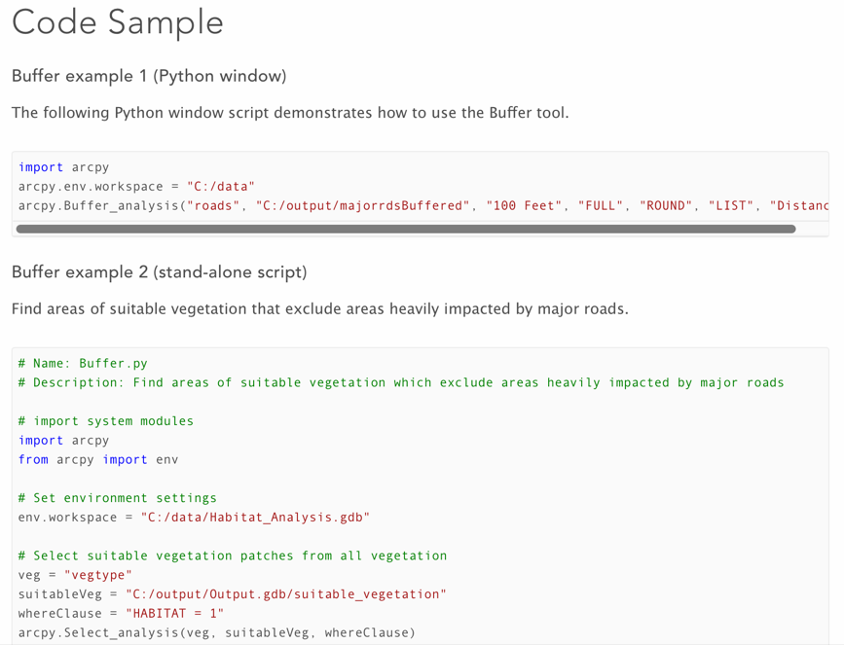
The Buffer Tool in ArcGIS

Slide 11


Slide 12

What is Git and why use Github?
Github is a code hosting website that uses the version control system Git, which was originally created by Linus Torvalds.
Git allows you to create versions, most simply through committing changes to a database.
Allows you to revert back if you make a mess.
Can also be used for collaboration/dissemination of your work.
Has bug/issue tracking and reporting system.

Slide 13
What is Git and why use Github?
Centers around “repositories” aka “repos” which hold your files in a structured manner.
Students (and just announced, now anyone) can have unlimited private (as well as public) repositories.
Private repos are only shared with your collaborators. Useful for crude (and embarrassing code that you don’t want to share).
Public are viewable and interactable by everyone.
It is not just for hosting code, can be for practically anything!
www.github.com

Slide 14
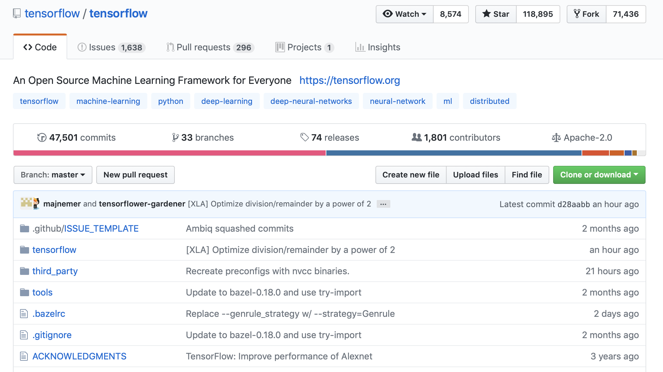
Notes:
1. Account name, plus slash and repository name.
2. Watch = People following bug fixes, commits etc. Star = like/thumbs up, not much tracking. Fork = creates a copy of the current repository that can be edited by yourself.
3. Issues = Reported issues, and bug tracking system. Pull requests = When you make a change, and are not a “committer”, you can suggest code changes that can be merged into a branch. Projects = Kind of a project management system that allows you to set up goals etc.
4. Commits = The changes that you make to the repository, i.e. you make some changes locally and then “commit” the change to the repository.
5. Branches = You may want to create a new branch to test out new features or experiment with a new idea. All without wrecking your main repository.
6. Releases = You can package up a “release” of your code, i.e. as an executable, zip file etc that would “lock” in your code at a certain time. I use releases when I have finished a paper, and use the release as an archive of the code status at the time of publication.
7. Contributors = If you have others working on your code, you may invite contributors.
8. License Type = You can select a license to protect your code if you wish, there are lots of them.
9. Branch selector = You can change branches here.
10. Pull request = You first make a branch, do your changes, and then you can submit a Pull request which will allow other contributors to to discuss the changes and potentially merge the changes into the main branch.
11. Clone or download = Most people will just download your code for review.
12. This is where your files/code are stored.

Slide 15
How will we run the class?
Syllabus and Schedule

Slide 16
Where is the syllabus and course materials?
I will regularly commit course materials to the Github Repository:
https://github.com/marecotec/Course_ArcGIS_Python
https://bit.ly/2Mpstgv
As this is a new course, materials will be added weekly, so you should at least Watch or Star the repo on Github.
Scan

Slide 17
What will we cover?
Jan 25 1. Introduction: Overview of different assignments for this class. Set up Github accounts. 2. Interacting with Python: The different Python environments and ways to interact with Python through ArcGIS (and not) – Python.exe, bat files, just clicking on a .py file, geoprocessing command line, PyCharm, toolboxes (.pyt and traditional).
Feb 1 3. Python basics: Commenting, import statements for packages, variables and data types (str, int, float, lists, tuples, dictionaries). Iteration using: for loops, if/elif/else statements, while statements. Code cleanliness (indentation using tabs/spaces, spotting indentation errors), Using Functions to block code. Zero-based indexing.
Feb 8 4. Python modules: Cover modules such as os, sys. Basic file and system manipulation.
Feb 15 5. Arcpy module: Present basic arcpy functionality, where can you find scripts and information, cover basic functionality. Setting environments within arcpy.
Feb 22 6. Building basic scripts: Cover basic coding tasks, and introduce error handling, print statements and various messaging functionality.

Slide 18
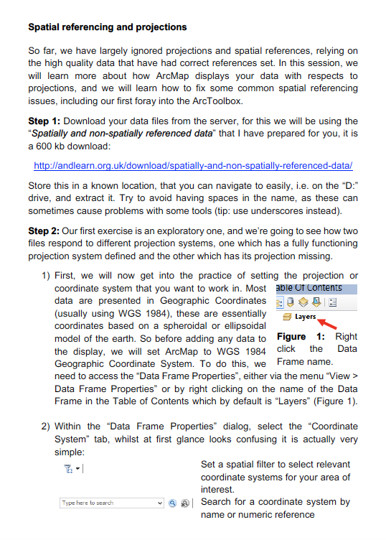
How I layout materials
Example!
To create workflows, classroom assignments etc, I use Microsoft Word. I deeply apologize for this! But I save the file as both a Word Doc (*.docx) and a PDF (*.pdf).
Why?
Easy to layout, share and print.
I can make changes pretty quickly.
Negatives code formatting a pain.

